Slide 1




Case studies for Bio + ML Opportunities and Challenges
Dr Mengyan Zhang
NCI, Australia
University of Oxford

Slide 2
What we will cover
Case study 1: AlphaFold
Case study 2: Sequential design of biological sequences
Opportunities and challenges

Slide 3
Case study 1: AlphaFold

Slide 4
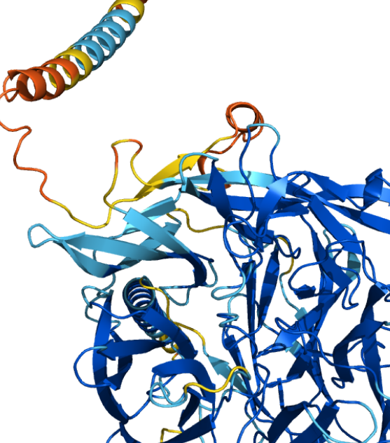
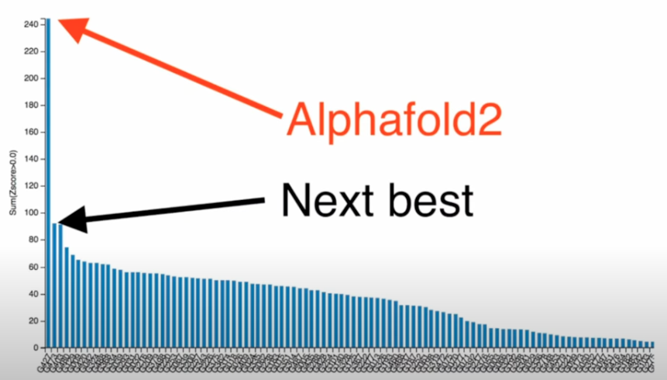
AlphaFold2
AI system developed by DeepMind that predicts a protein’s 3D structure from its amino acid sequence
https://alphafold.ebi.ac.uk/

Slide 5
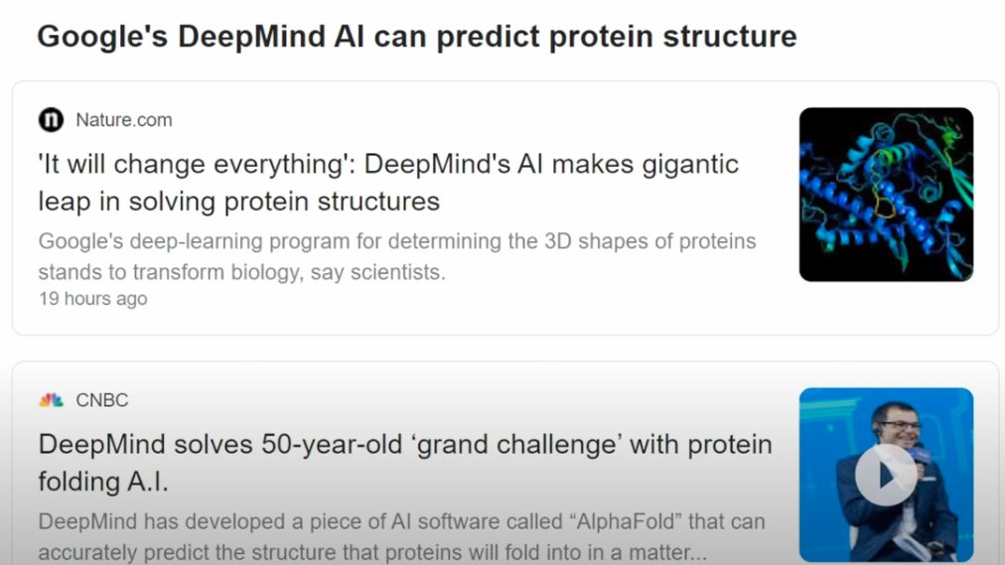

Slide 6
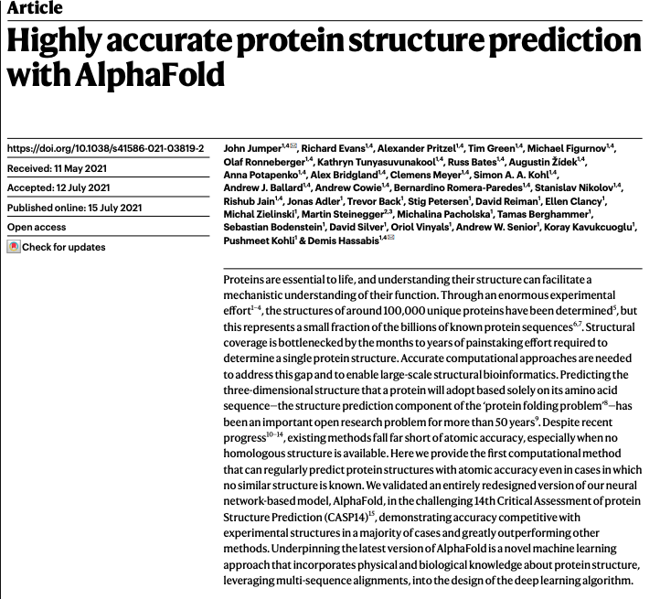
https://www.nature.com/articles/s41586-021-03819-2

Slide 7
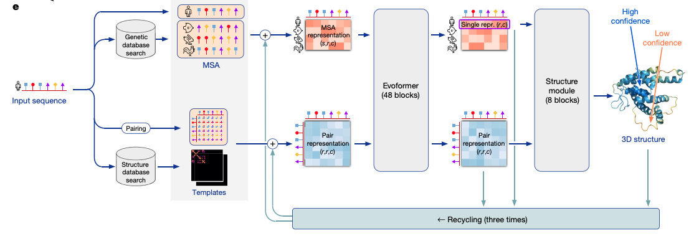
AlphaFold2: Model Architecture
Multiple sequence alignment
Pairwise distance plot

Slide 8
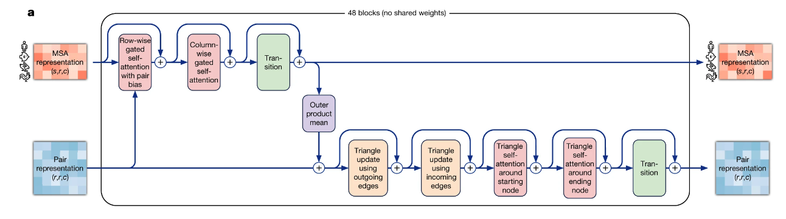
Evoformer block

Slide 9
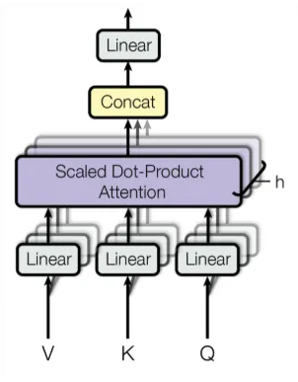
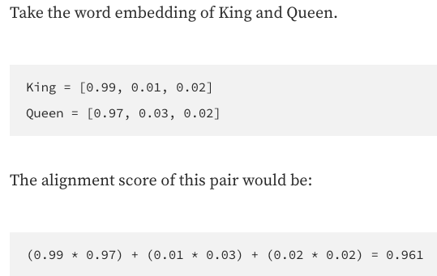
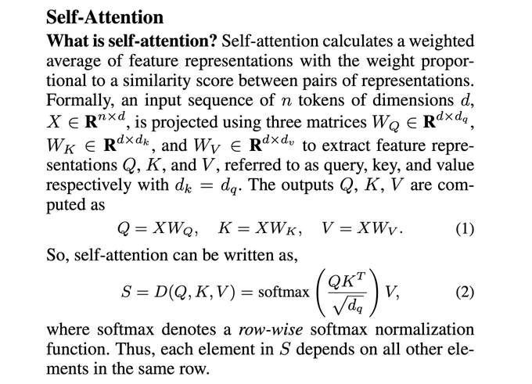
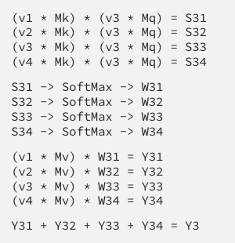
Self-attention
Dot product similarity to find alignment scores
Normalization of the scores to get the weights: softmax
Reweighing of the original embeddings using the weights
https://towardsdatascience.com/an-intuitive-explanation-of-self-attention-4f72709638e1

Slide 10
How to use AlphaFold2
The alphaFold protein structure database https://alphafold.ebi.ac.uk/
Play around and predict using the model
AlphaFold colab https://colab.research.google.com/github/deepmind/alphafold/blob/main/notebooks/AlphaFold.ipynb#scrollTo=rowN0bVYLe9n
AlphaFold 2 is here: what’s behind the structure prediction miracle by Oxford Protein Informatics Group https://www.blopig.com/blog/2021/07/alphafold-2-is-here-whats-behind-the-structure-prediction-miracle/

Slide 11
Case study 2: Sequential design of biological sequences

Slide 12
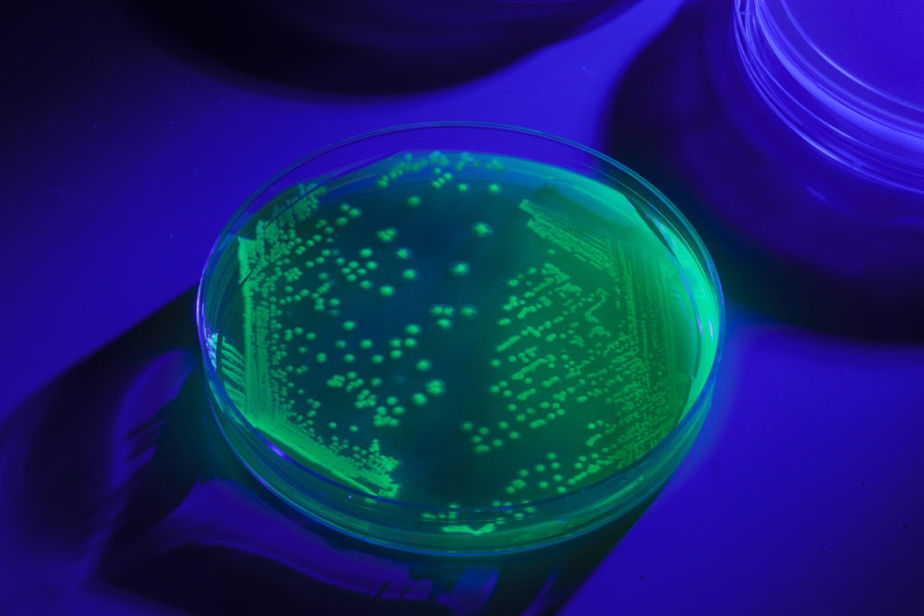
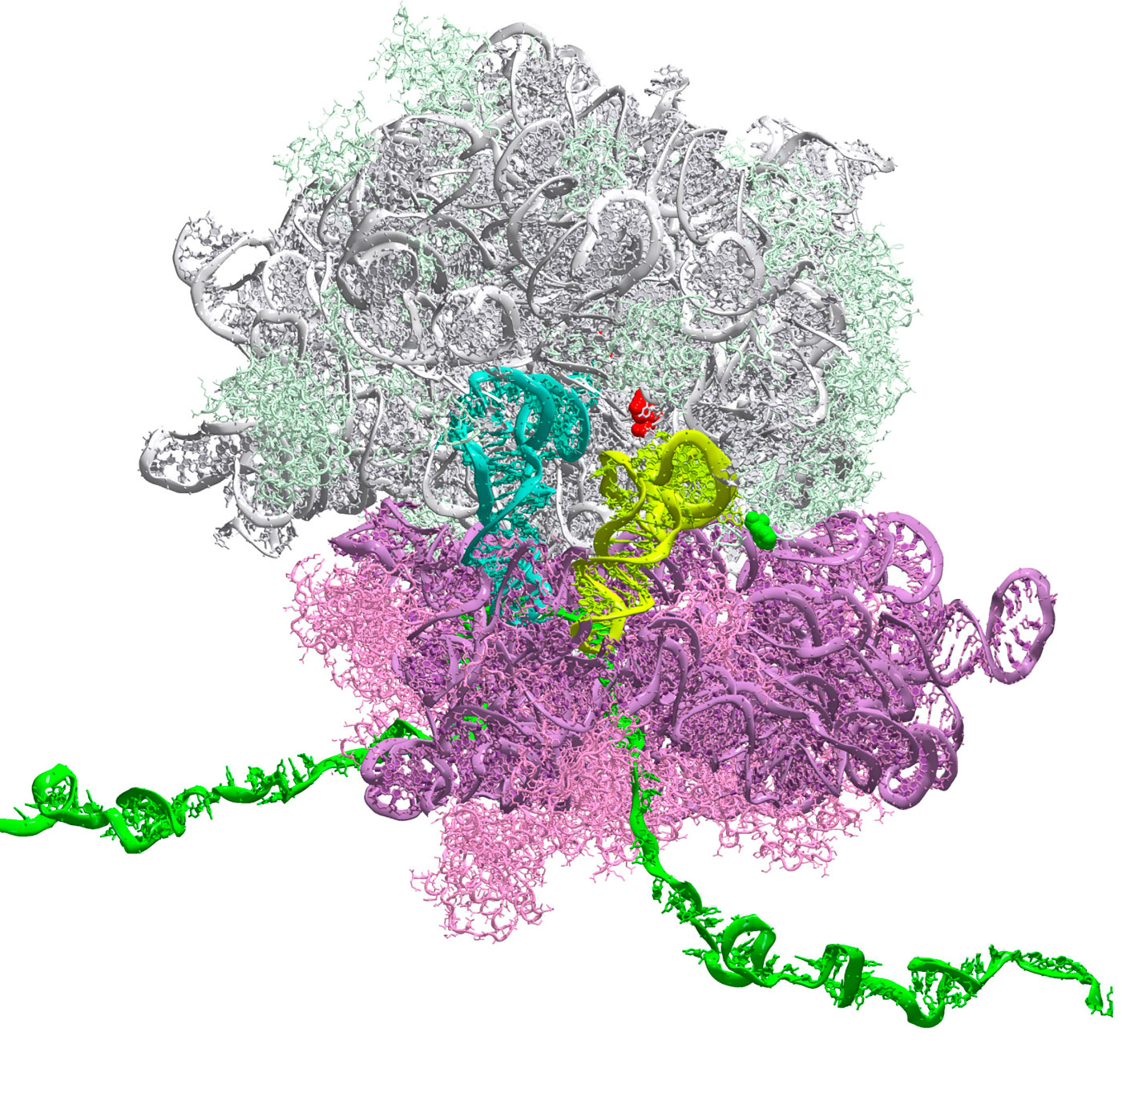
Bandits for Synthetic Biology
With fixed budget (450), design Ribosome Binding Site (RBS) sequences in batches (4)
(300 for bandit groups)
Optimize the protein expression level (translation initiation rate)
Identify the RBS sequences with highest possible protein expression level
Arm: RBS sequence | Reward: Normalized* Translation Initiation Rate
TTTAAGAGTTATATATACAT | 1.58
TTTAAGAATATGCTATACAT | 1.42
TTTAAGACTCGGATATACAT | 0.14
TTTAAGAGTTTTTTATACAT | 2.88
Green Fluorescent Protein (GFP)
Design space: 4096 sequences
* zero mean and unit variance normalization $z=\frac{x−μ}{σ}$

Slide 13
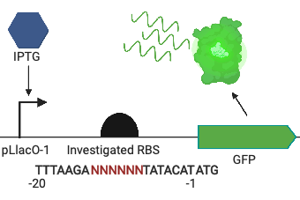
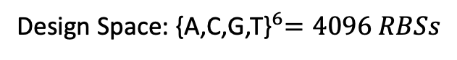
$\text{Case} \text{Study}$: E. coli RBS Design
Design Space:${ \text{\{}\text{A}\text{,}\text{C}\text{,}\text{G}\text{,}\text{T}\text{\}}}^{6}=4096 RBSs$
with total 4 DBTL cycles (450 RBSs)
2

Slide 14
The RBS Problem
Ribosome Binding Site (RBS) controls protein expression level
Translation Initiation Rate (TIR) of is hard to predict and is expensive to label
RBS calculators are based on thermodynamic data
Notes:
Example of small genetic part

Slide 15
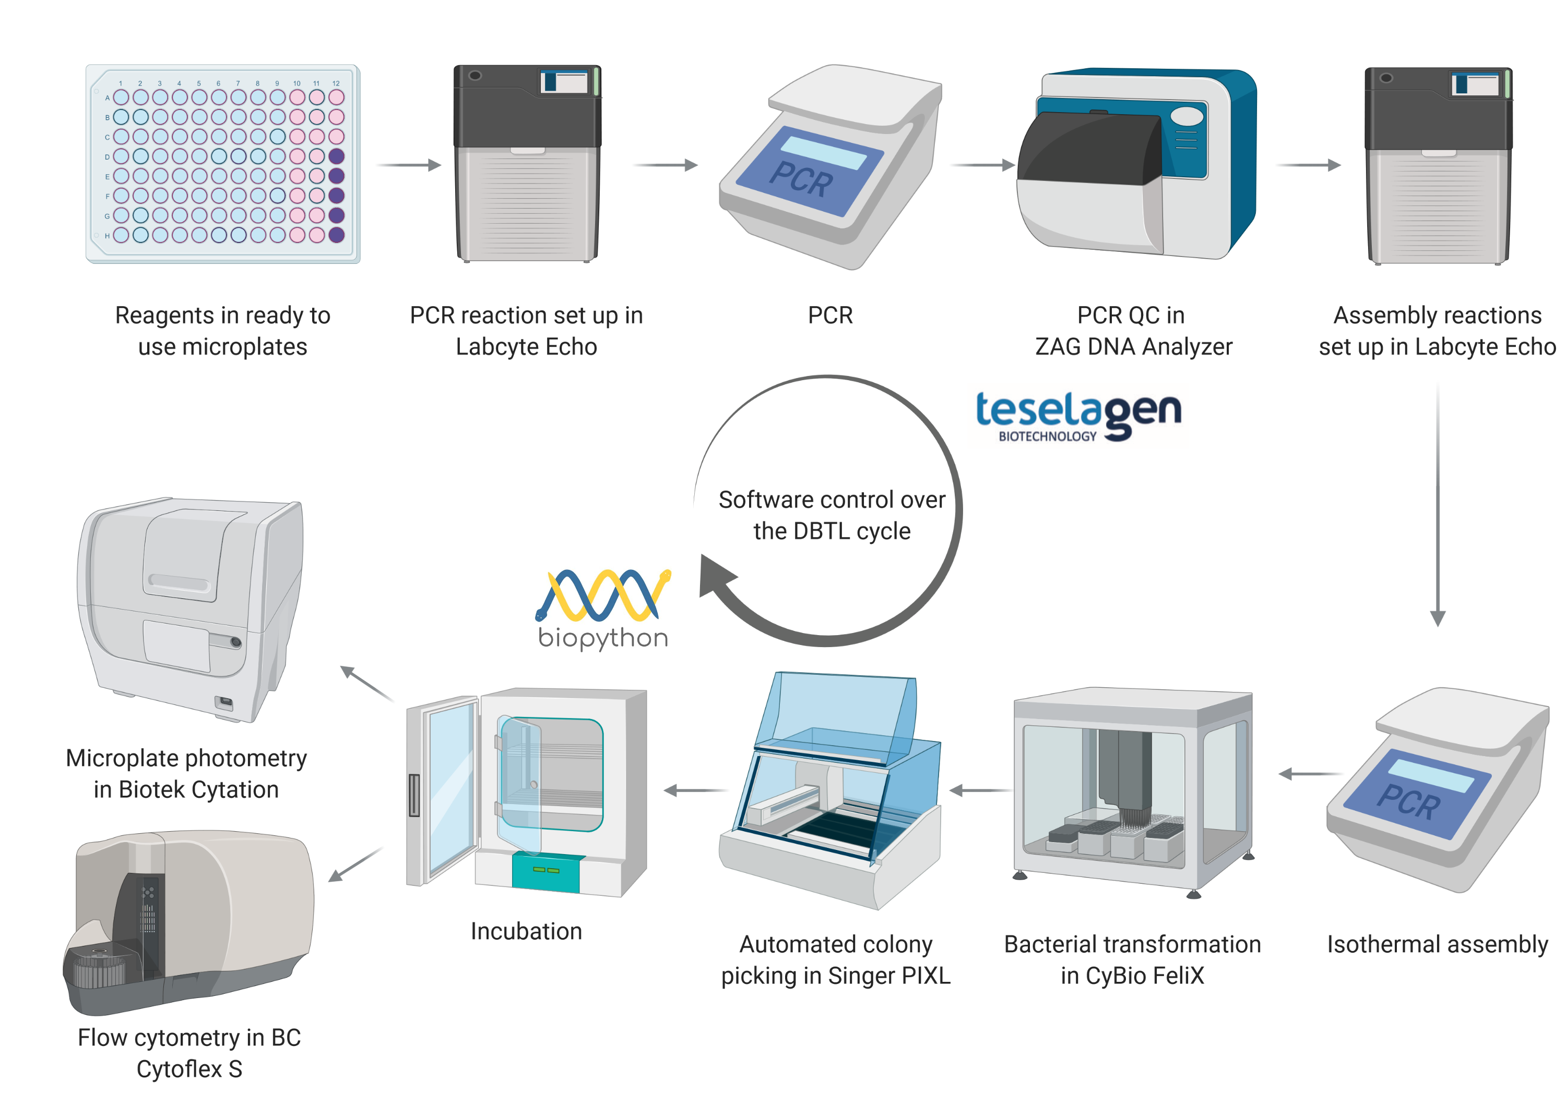


High-throughput RBS engineering

Slide 16
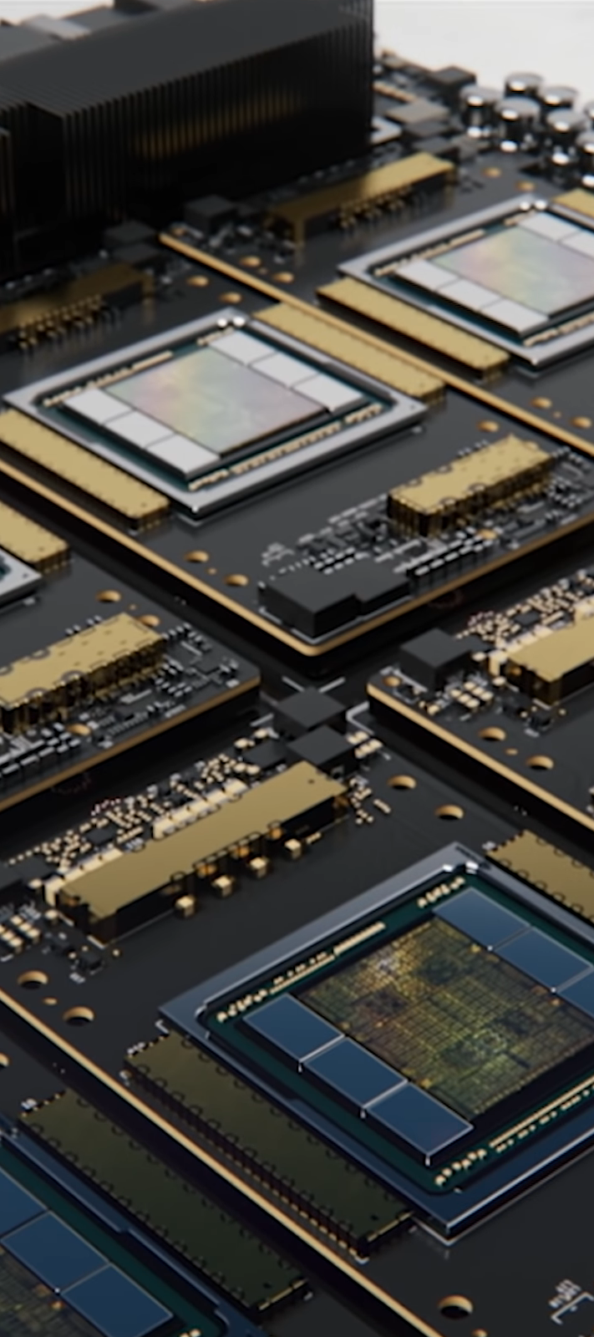
Machine Learning Algorithms
A (Bayesian) regression algorithm which predicts both
Mean
Uncertainty
An online/batch algorithm which recommends sequences to design
Gaussian Process Regression
Multiarmed Bandits Algorithms:
Upper Confidence Bound

Slide 17
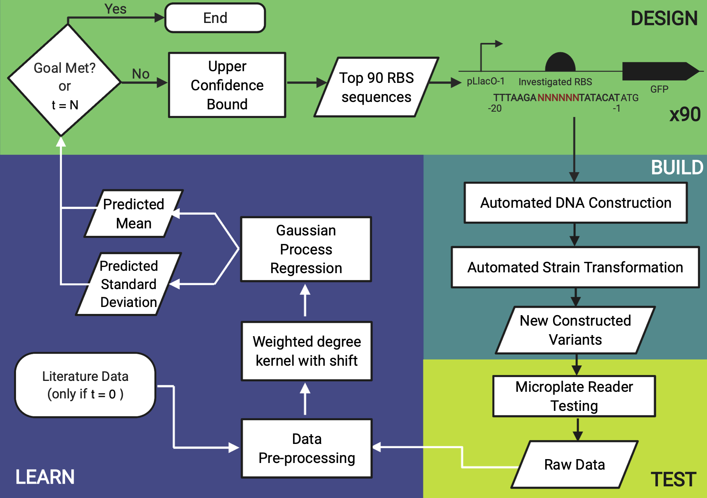
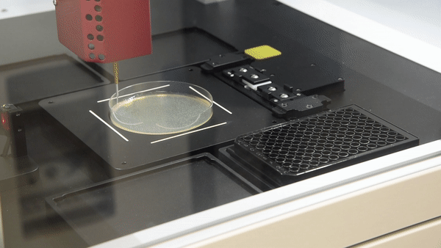
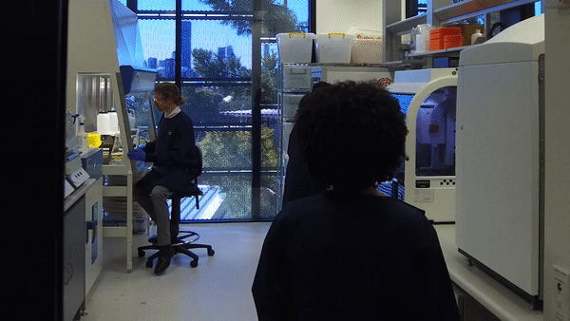
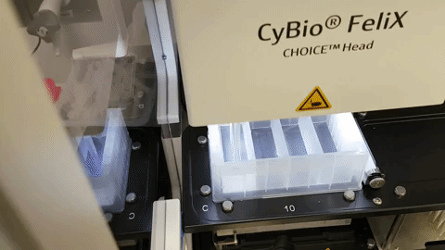
Design-Build-Test-Learn (DBTL) Cycle
CSIRO BioFoundry Lab

Slide 18
Design-Build-Test-Learn (DBTL) Cycle

Slide 19
Results: swarmplot

Slide 20
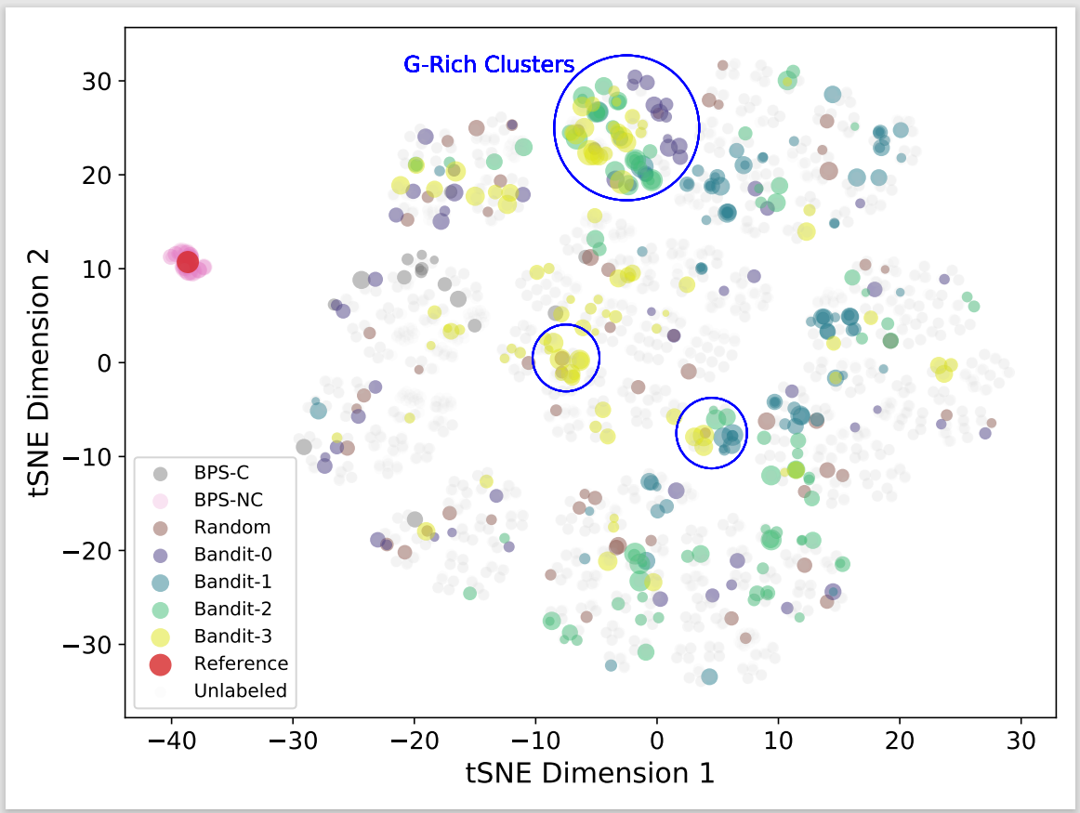
t-SNE
Notes:
More specifically, sequences with 4 or more guanines in any position constituted 10%of the randomly selected sequences and 5, 9, 16 and finally 25% in each of the 4 Bandit guided batches respectively

Slide 21
Recommendations: Exploration vs Exploitation

Slide 22
Summary
Top RBS Core | TIR Ratio
GGGGGC | 1.34
GGGGGT | 1.15
GGCTAT | 1.08
AGGAGA | 1
GGCGTT | 0.98
GGGGGG | 0.98
GGCGAC | 0.98
CAGGAG | 0.96
GGCGAG | 0.95
AGGAGG | 0.39
Biologically important rules found
Significant decrease in discovery time
Reliable library with a number of very strong RBSs

Slide 23
Lessons learned and future opportunities
ML (Bandits) guided DBTL cycle -- increase expression of our target protein by up to 35%, compared to a strong benchmark RBS
Generalisation of our workflow: target on larger design space, more complicated genetic elements, e.g. promoters

Slide 24
Opportunities and Challenges

Slide 25
Opportunities and Challenges
Measurement Noise and Data Normalisation
Exploitation-Exploration Trade-off
Representation of Biological Sequences
Generalisation of Our Workﬂow
Evaluation and Interpretability
Interdisciplinary Collaboration

Slide 26
Opportunities and Challenges
Measurement Noise and Data Normalisation
Exploitation-Exploration Trade-off
Representation of Biological Sequences
Generalisation of Our Workﬂow
Evaluation and Interpretability
Interdisciplinary Collaboration

Slide 27
Opportunities and Challenges # 1: Measurement Noise and Data Normalisation
our automated lab workflow returned 79% constructs with coefficient of variation (STD/AVERAGE) less than 40%
we successfully got 99% of constructs
For each bandit batch in our case study, there was noise per sequence (6 replicates) in each batch, and noise between batches: proper normalisation methods needed for non-independent sampling.
Each RBS: test 6 biological replicates
3

Slide 28
Opportunities and Challenges
Measurement Noise and Data Normalisation
Exploitation-Exploration Trade-off
Representation of Biological Sequences
Generalisation of Our Workﬂow
Evaluation and Interpretability
Interdisciplinary Collaboration

Slide 29
Opportunities and Challenges # 2: Exploitation-Exploration Trade-off
Exploration: unknown (untested) RBS design space with potentially high label
Exploitation: querying areas that are predicted to give relatively high labels.
4

Slide 30
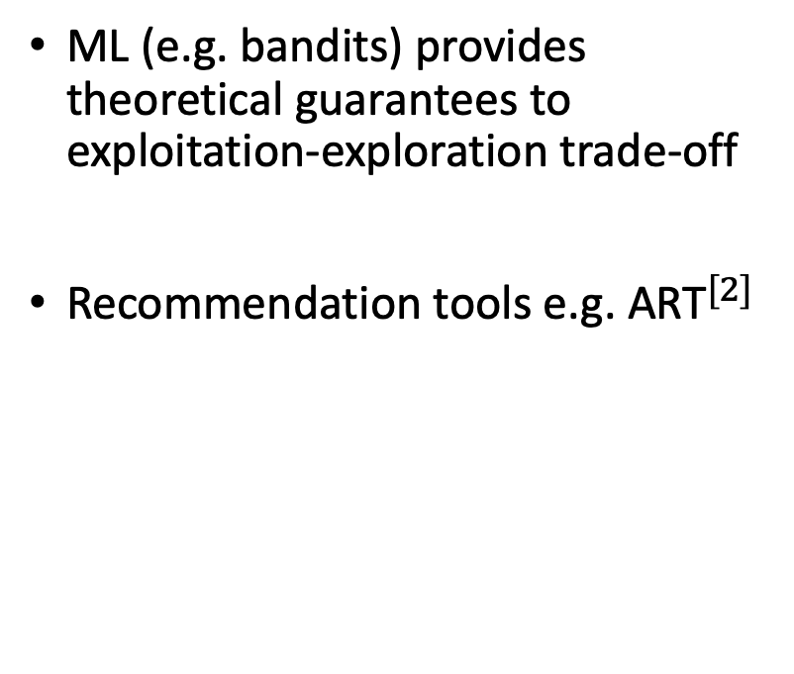
Opportunities and Challenges # 2: Exploitation-Exploration Trade-off
ML (e.g. bandits) provides theoretical guarantees to exploitation-exploration trade-off
Recommendation tools e.g. ${\text{ART}}^{[2]}$
Gaps between theory and practice: how to choose a hyperparameter for GP-BUCB that controls the exploration-exploitation trade-off in the interactive DBTL cycles?
How to deal with structured discrete design spaces?
[2] Radivojevi´c, T., Costello, Z., Workman, K., and Martin, H. G. A machine learning automated recommendation tool for synthetic biology. Nature communications, 11(1): 1–14, 2020.
5

Slide 31
Opportunities and Challenges
Measurement Noise and Data Normalisation
Exploitation-Exploration Trade-off
Representation of Biological Sequences
Generalisation of Our Workﬂow
Evaluation and Interpretability
Interdisciplinary Collaboration

Slide 32
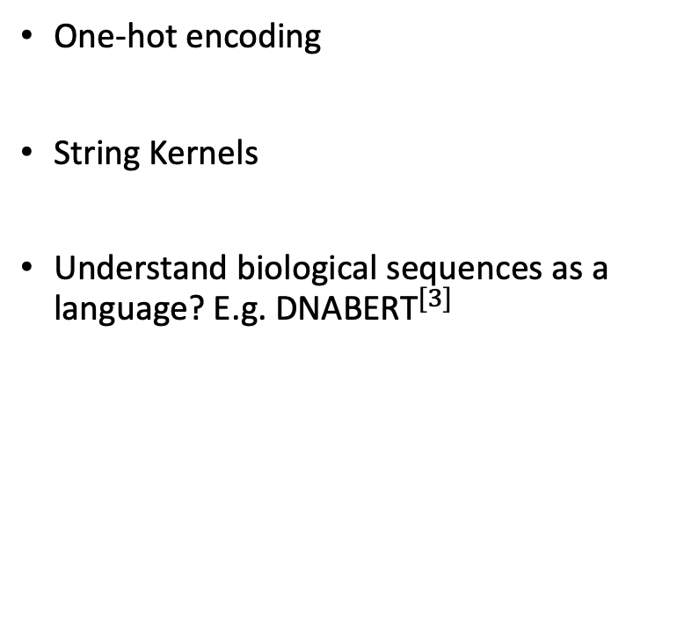
Opportunities and Challenges # 3: Representation of Biological Sequences
One-hot encoding
String Kernels
Understand biological sequences as a language? E.g. ${\text{DNABERT}}^{[3]}$
high dimensionality coupled with a low sample size
Whether the model pre-trained E. coli can be transferred to yeast?
Will a representation that works well for RBSs also work well for promoters?
how to split biological sequences into meaningful words?
[3] Ji, Y., Zhou, Z., Liu, H., and Davuluri, R. V. Dnabert: pre-trained bidirectional encoder representations from transformers model for dna-language in genome.
6

Slide 33
Opportunities and Challenges
Measurement Noise and Data Normalisation
Exploitation-Exploration Trade-off
Representation of Biological Sequences
Generalisation of Our Workﬂow
Evaluation and Interpretability
Interdisciplinary Collaboration

Slide 34
Call to action
“
”
scientific revolutions occur when there is cross pollination of ideas
-- Thomas Kuhn
8

